Slide 1
Uncontrolled copy not subject to amendment
Principles of Flight
Learning Outcome 1
Understand the principles of flight
Part 1: Identify factors that affect the creation of lift in an aircraft in flight
Revision 2.00

Slide 2
Lift and Weight
Objectives:
State Newton’s Third Law
Explain weight and lift for straight and level flight
Describe Bernoulli’s Principle
Explain how an aerofoil affects airflow and produces lift
Have a knowledge of simple aerodynamic terms
Identify and define parts of an aerofoil cross-section
Describe how airspeed, angle of attack, air density,
wing shape and area affect lift
Notes:
What is Newton’s third Law?
Elicit the answer from the audience.
Show the car coming in from the side and the boat and show that either the ground or water support the weight of the car and boat.
But when supported they can be stationary.
But for aircraft, they can only be supported as long as they move!!

Slide 3
Newton’s Third Law states that:
“To every action there is an equal and opposite reaction”
1 Tonne
10 Tonnes
1 Tonne
10 Tonnes
Notes:
What is Newton’s third Law? Elicit the answer from the audience.
Show the car coming in from the side and then the boat to show that either the ground or water support the weight of the car and boat.
But when supported they can be stationary.
But for aircraft, they can only be supported as long as they move!!
Sir Isaac Newton formulated laws which explain the way things move.
His Third Laws states that “to every action, there is an equal and opposite reaction”.
So how does this apply to everyday objects such as cars, boats and aircraft?
Imagine a car weighing, say, 1 tonne parked on the road. The car’s weight presses down on the road with a force of 1 tonne - and from Newton’s law we know that to support the car, the road must press up with a force of 1 tonne. Similarly a boat weighing, say, 10 tonnes is supported by an upward force (from the water) of 10 tonnes - otherwise it would sink!
The same must apply to an aircraft in flight. But how can an aircraft, which might weigh many tones, be supported by such a flimsy substance as air? The clue is in the fact that whereas cars and boats are supported by the road (or water) when in motion and also when they are stationary, an aircraft can only stay airborne as long as it moves (except for the Harrier of course).

Slide 4
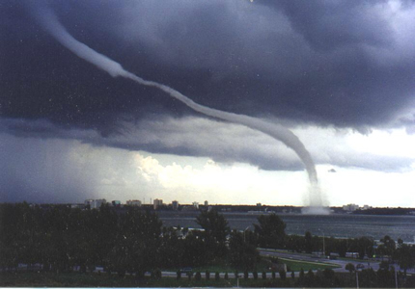
Air
What is air?
Can we feel it?
Can we see it?
What is it doing?
Notes:
The fact that air is really a substance is not immediately obvious, especially indoors.
Move your hand backwards and forwards quickly, what do you feel?
But looking outside we can see trees waving and smoke moving in the air.
Remember riding a bicycle into a strong wind?
Look at the ever increasing number of wind turbines being built.
What is it doing?
It is exerting a force on any objects in its’ path.

Slide 5
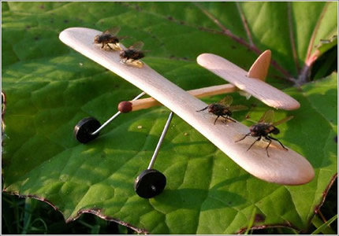
Moving objects through the air
Notes:
The force exerted on stationary objects is one thing, but what happens if the air is still and the object moves?
The same thing!!
Remember riding a bicycle into a strong wind?
Either way air exerts a force on a body.

Slide 6
Weight
Weight
(Gravity)
Lift
Notes:
Explain how the stool is lifted and how gravity is trying to pull it down.
More “muscular” effort and it goes up and vice versa.

Slide 7
Weight
(Gravity)
Less effort =
Less lift!
Lift
Notes:
Explain how the stool is lifted and how gravity is trying to pull it down.
More “muscular” effort and it goes up and vice versa.

Slide 8
Weight
(Gravity)
More effort=
More lift!
How is this lifting force given to an aircraft?
Lift
Notes:
Explain how the stool is lifted and how gravity is trying to pull it down.
More “muscular” effort and it goes up and vice versa.

Slide 9
Lift
Work in pairs:
Hold 2 sheets of A4 paper, about a finger’s width apart
Blow hard down the gap
WHAT HAPPENS?
Did they separate or come together?
Why does a slightly open door close when a draught blows through the gap, rather than open?
NOW!
Your turn to do some work!
Notes:
Have lots of A4 paper available so that all of the audience can have a try.
Try holding two sheets of A4 paper with the edges vertical and about one finger’s width apart. You would imagine that by blowing hard down the gap between the two papers they would be blown apart.
The opposite happens! The harder you blow, the more firmly the papers are drawn together!
Similar effects can be seen in everyday life - a slightly open door closing rather than opening when a draught blows through the gap, and canal barges drawn together when they pass each other. What causes these things to happen? To find out we use a wind tunnel to experiment.

Slide 10
Lift – Wind tunnel tests
-
-
A
+
+
C
B
Air enters at ‘A’
On reaching ‘B’ it has increased in speed to get through the narrower gap
At ‘C’ the air has returned to the same values as ‘A’
If speed increases then pressure drops and vice versa
How does this work as a wing?
Notes:
Air flowing past a stationary object.
Air blows from A to C through a restriction.
Air cannot be “stored” at B, so something else happens:
From A to B the airspeed increase and slows from B to C. This affects the pressure of the air.
This is a complicated theory called Bernoulli’s Principle (explained below if relevant) but all we need to know is that if the air speeds up when passing B then the air pressure drops.
Remember what happens to the 2 pieces of paper when blowing between them?
The Venturi Effect could also be mentioned. The Venturi Effect is the reduction in fluid pressure that results when a fluid flows through a constricted section of pipe.

Slide 11
LIFT
-
-
A
+
+
C
B
+
A Wing works in the same way as the wind tunnel
Because the air is faster over the top surface, the pressure is decreased
The wing is now producing lift
Notes:
Now cut the “wind tunnel in half and we have a wing – this works in the same way.
Replace the tunnel with a wing and the effect is the same.
Explain that when the curvature (camber) is greater then more lift is generated.
Now you know why it is not a good idea to stand close to a railway platform’s edge!

Slide 12
NOW!
Your turn to do some
more work!
What happens when we blow over a sheet of paper?
This is Bernoulli’s Principle
Notes:
Have lots of A4 paper available so that all of the audience can have a try.
Now try blowing over just one sheet and see what happens. This demonstrates the effect of increased airflow speed over the wing and decreased pressure ie Lift.
Bernoulli’s Principle
As there is no way that air can be stored in the constriction, the amount of air leaving the tunnel must be the same as the amount of air entering it. Therefore, the air must speed up to pass through the narrowest point. In the previous slides, as the air moves from “A” to “B” its speed increases, reaching a maximum at “B”. Moving from “B” to “C” the speed decreases, eventually returning to the same speed as before.
These speed changes have an effect on the pressure of the air in the airflow, and that effect is governed by Bernoulli’s Principle.
Bernoulli’s principle states that when air is moving in a streamlined flow (i.e. smooth and not turbulent), in areas where the airspeed increases, the air pressure decreases; and conversely, where the airspeed decreases, the air pressure increases.
In our experiment, this means that the pressure recorded at “B” will be lower than at “A” and “C”. If you think back to your experiment with the two pieces of paper, when you blow between the papers, the speed of the air between the sheets causes its pressure to drop, which allows the pressure on the outside to push the sheets together. Can you now explain why two canal barges are drawn together when they pass, travelling in opposite directions?
Bernoulli’s principle is true for all fluids (i.e. water and air).

Slide 13
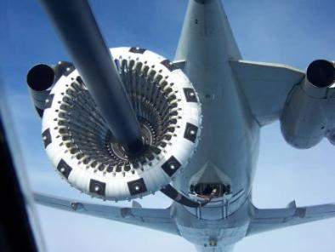
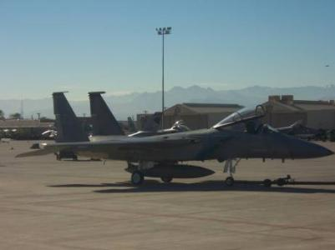
DEFINITIONS
Notes:
A few definitions so that we can understand what is happening around a wing.

Slide 14
_
Total reaction
+
+
Pressure envelope
The line showing the magnitude of the static pressure above or below ambient
Total reaction (TR)
The ‘resultant’ of all the aerodynamic forces, usually on the aerofoil only (as in the illustration)
Notes:
PRESSURE ENVELOPE
The line showing the magnitude of the static pressure above or below ambient
TOTAL REACTION
The ‘resultant’ of all the aerodynamic forces, usually on the aerofoil only (as in the above illustration)

Slide 15
_
Total reaction
+
CP
+
Centre of pressure
The point at which the total reaction is assumed to act
Notes:
CENTRE OF PRESSURE
The point at which the total reaction is assumed to act

Slide 16
Lift
Total Reaction
_
Free Stream
Flow
Drag
+
+
Lift
The component of the total reaction which is ‘perpendicular’ to the free stream flow (and therefore perpendicular to the flight path)
Drag
The component of the total reaction which is ‘parallel’ to the free stream flow (and therefore parallel to the flight path
Notes:
LIFT
The component of the total reaction which is ‘perpendicular’ to the free stream flow (and therefore perpendicular to the flight path)
DRAG
The component of the total reaction which is ‘parallel’ to the free stream flow (and therefore parallel to the flight path)

Slide 17
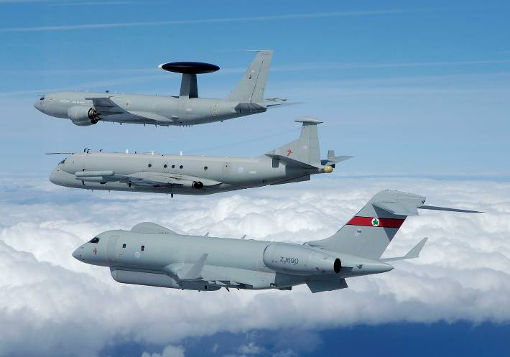
Distribution of lift
Notes:
The whole surface of a wing, both top and bottom, is affected by the airflow. In other words, there are pressure forces acting all over the wing - and it follows that there can be lift forces all over the wing. The arrows on the diagram show how the lift forces might appear on a typical wing in normal level flight. The length of each arrow indicates the amount of lift at that point on the wing’s surface.
Note that:
1. Lift is not distributed evenly around the wing
2. The top surface normally generates more lift than the bottom surface – at some angles of attack, as much as 80% of the total!
3. The greatest amount of lift on the top surface occurs where the surface is curved the most
4. The greatest effect, on both top and bottom surfaces, is nearer the front edge of the wing than the rear (that is, about a third of the way from the front)
5. All lift forces act at 90° to the direction of the airflow - which is the same as the flight path of the aircraft
The next few slides are examples of lift around a wing at various angles of attack.

Slide 18
Pressure envelope at 0°
_
+
0°
_
+
Lift – a little
Notes:
PRESSURE ENVELOPE

Slide 19
Pressure envelope at 5°
_
5°
+
_
+
Lift - more

Slide 20
Pressure envelope at 10°
_
10°
+
+
Lift - more

Slide 21
Pressure envelope at 15°
_
+
15°
+
Lift - more

Slide 22
Straight and level flight
What forces are affecting the aircraft?
Lift
Drag
Thrust
Centre of gravity (CG)
Weight
Are these forces in balance for straight and level flight?
Which point do these forces act through?
Notes:
What forces are present in straight and level flight?
Where do these forces act through? Show Centre of Gravity (CG).
Could show CG using an odd shaped object

Slide 23
More definitions
Leading edge
Trailing edge

Slide 24
Leading edge
Trailing edge
Chord line
The straight line passing through the Centres of Curvature of the Leading and Trailing Edges of an Aerofoil.

Slide 25
Free stream flow
The airflow remote from the aircraft and
unaffected by its presence. Sometimes
called the relative airflow
Notes:
FREE STREAM FLOW (Relative Airflow)
The Airflow remote from the Aircraft, and unaffected by its presence. Sometimes called the Relative Airflow.

Slide 26
α
Free Stream Flow
Angle of attack (AoA) Symbol α (alpha)
The angle between the chord line and
the free stream flow
Notes:
ANGLE OF ATTACK Symbol α (alpha)
The Angle between the Chord Line and the Free Stream Flow.

Slide 27
Cambered aerofoil
A general purpose aerofoil with a large “curved” surface.
Large camber = More lift
But, what wing shape do fighter aircraft have?
Notes:
Discuss wing shape and the fact that “fat” wings produce shock waves because the air is sped up more over a highly cambered wing etc.
Also mention that thin wings are not good for low speed and therefore fighters land and t/o at high speeds.

Slide 28
Mean Camber Line
Free Stream Flow
Mean camber line
The line equidistant from the upper and lower
surfaces of the aerofoil section
Notes:
MEAN CAMBER LINE
The line ‘equidistant’ from the upper and lower surfaces of the aerofoil section.

Slide 29
Mean Camber Line
Free Stream Flow
Cambered aerofoil
If the mean camber line lies above the chord line (as in the above illustration) the aerofoil section has positive camber it is a cambered aerofoil
Notes:
CAMBERED AEROFOIL
If the mean camber line lies above the chord line (as in the above illustration) the aerofoil section has ‘positive camber’; it is a cambered aerofoil

Slide 30
Symmetrical aerofoil
If the mean camber line is co-incident
with the chord line it is a symmetrical
aerofoil section
Notes:
SYMMETRICAL AEROFOIL
If the mean camber line is ‘co-incident’ with the chord line it is a symmetrical aerofoil section

Slide 31
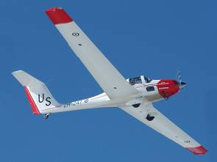
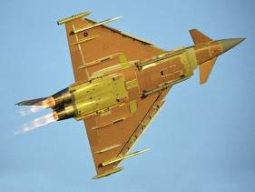
Wing shape and area
Low aspect ratio 2.4:1
High aspect ratio 16:1
Aspect ratio
The ratio of : wing span
wing span²
or
wing area
mean chord
Notes:
ASPECT RATIO
The ratio of : wing span OR wing span2
mean chord wing area

Slide 32
Factors affecting lift
Factors already discussed:
Angle of attack (AoA)
Wing shape – camber
Wing area
Additional factors:
Air density
Airspeed
Notes:
Discuss air density and its change with height i.e. thinner.
Also discuss airspeed and if you need a demonstration then get the audience to blow slowly and quickly over the piece of paper.
This slide can be used for revision.

Slide 33
Any questions?

Slide 34
Questions for you …..

Slide 35
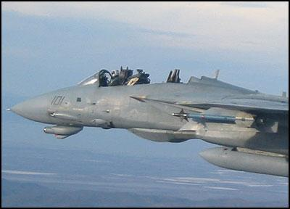
1. Newton’s Third Law states that:
Every object has weight
Weight equals lift during flight
Every action has an equal and opposite reaction
Every force causes an object to move

Slide 36
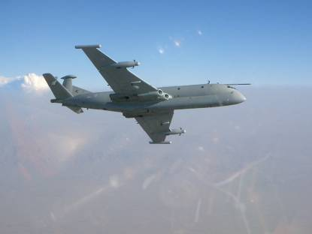
2. In which direction does LIFT operate relative to airflow?
Parallel to it
Perpendicular (at 90º) to it
c. Straight up
d. Straight down

Slide 37
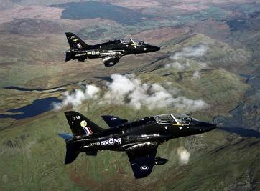
3. What has happened to the air pressure at point B?
A
C
B
It is greater than at point A
It is greater than at point C
It is the same as point C
It is lower than at point A

